Slide 1
ENSE 871 (885aw): Usability Research & Engineering
Activity 4
Team Float

Slide 2
Team Introduction Float
Akash Marwaha: 200467136
Dhruval Patel: 200438935
Oisharya Dhar: 200441728
Sangeeta Sharma: 200412260

Slide 3
Problems
Problems With the Current Site:
Less Recipient Engagement
Not Attractive
North Star Customer: Environmentalist, Social activist, Teacher, Students
Carry Over Customer : General People

Slide 4
WordPress configuration
Theme : 2020
Plug Ins:
Duplicate Page : To duplicate page for searching option
Elementor : For making page content and post
Graphina - Elementor Charts and Graphs : For inserting the desired pie chart
Post Type Switcher : To transform page to post
Search & Filter Pro : To add the search option
WPvivid Backup Plugin: For backup.

Slide 5

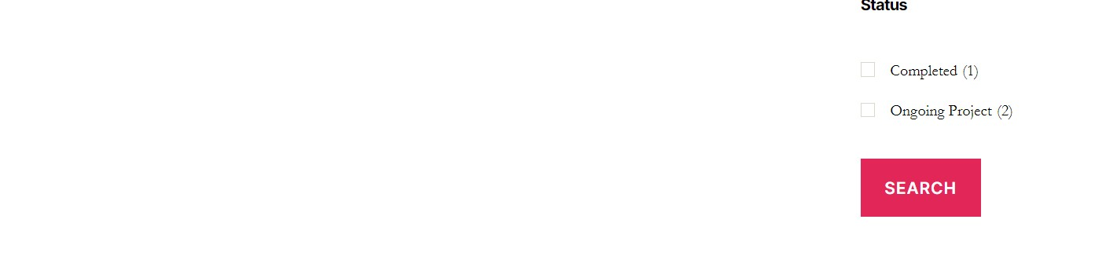
Demo( Screenshots)

Slide 6
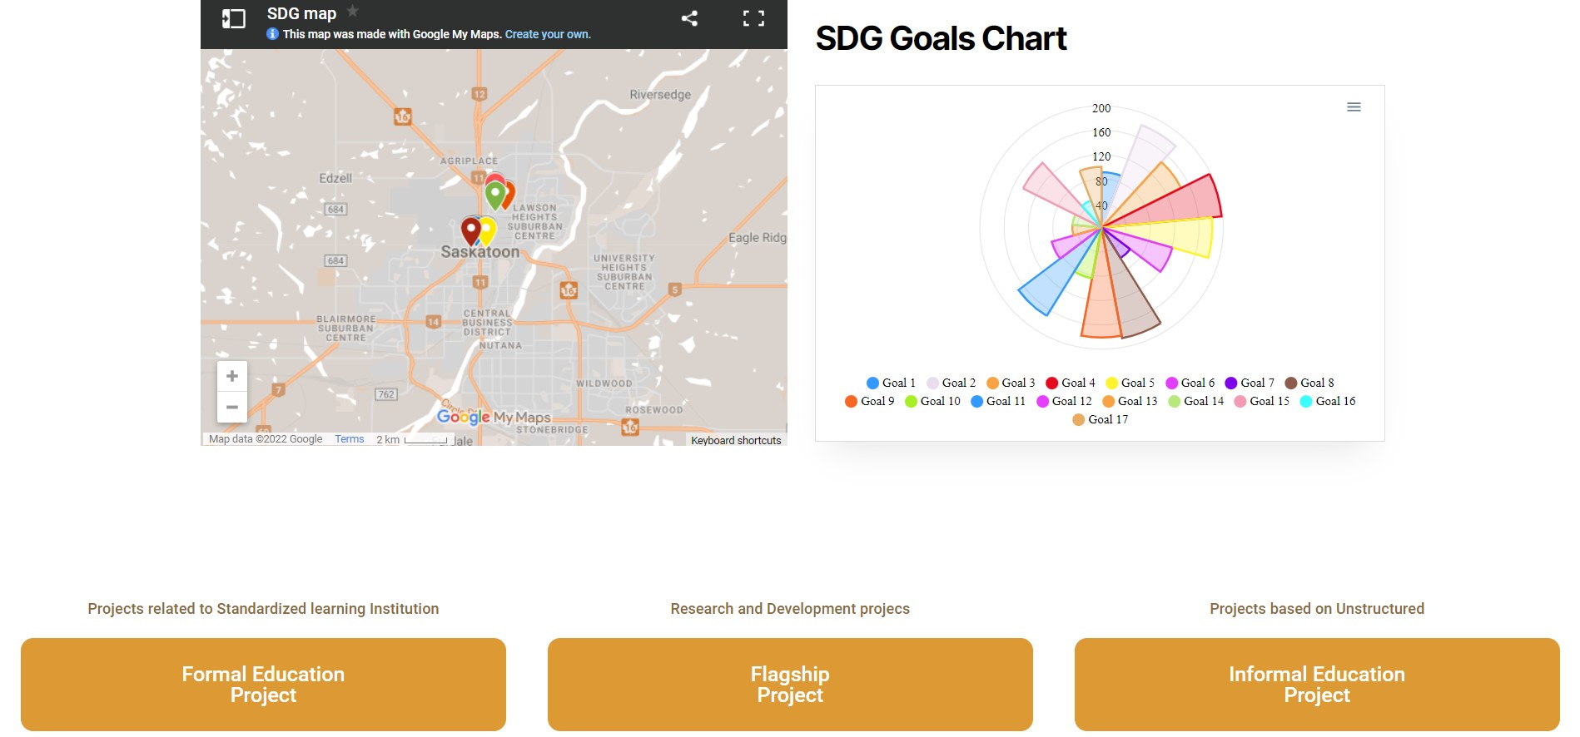
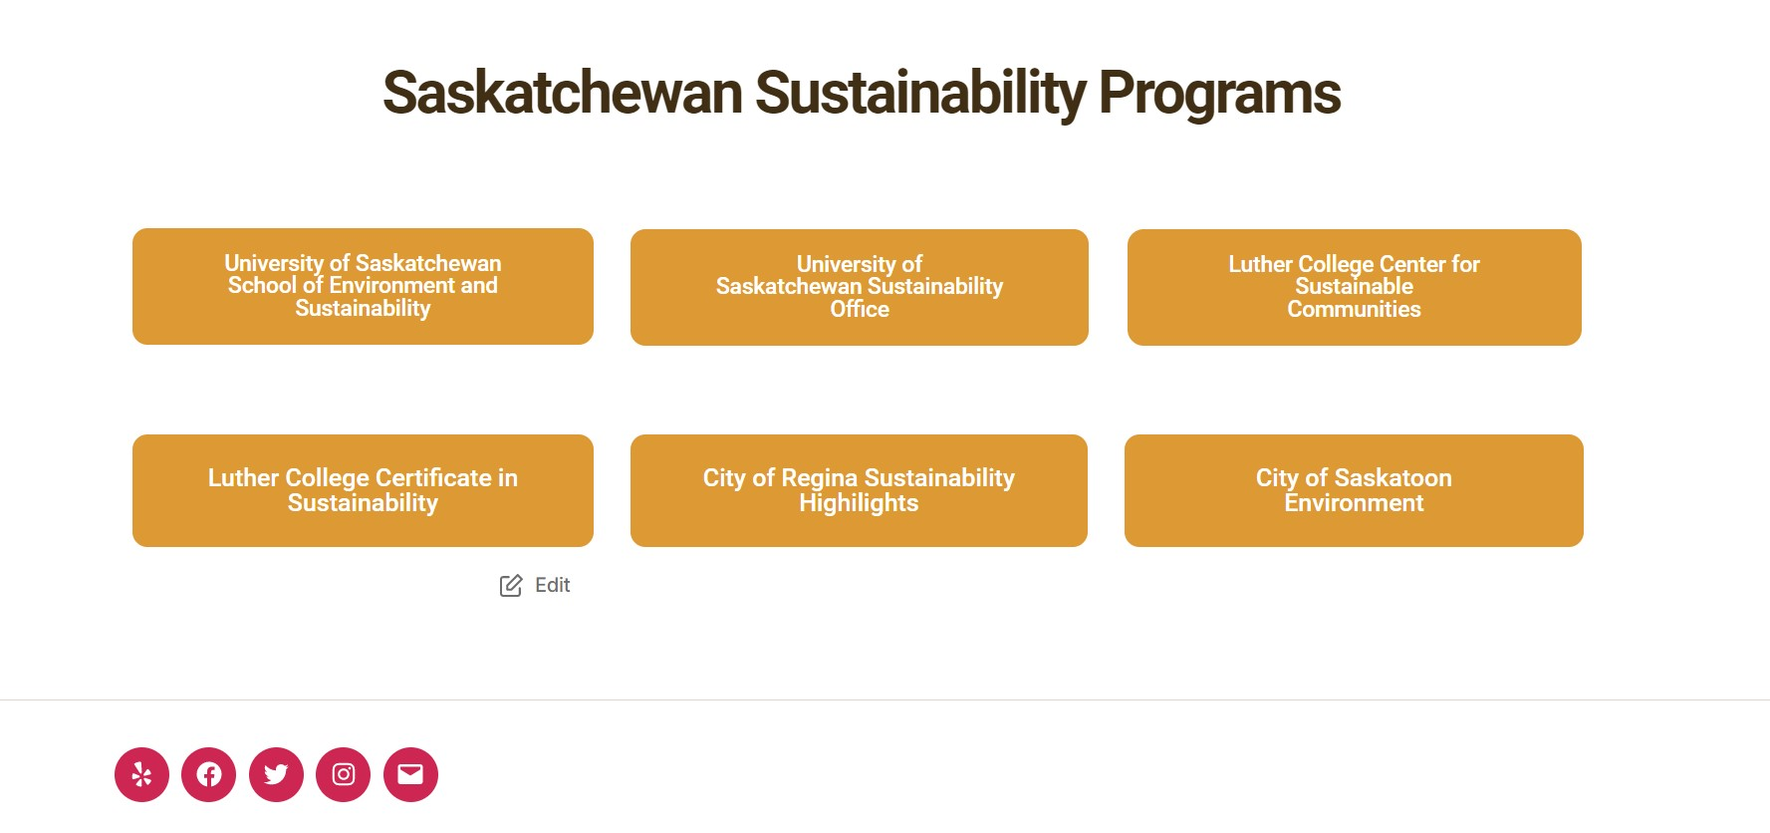
Demo( Screenshots)

Slide 7
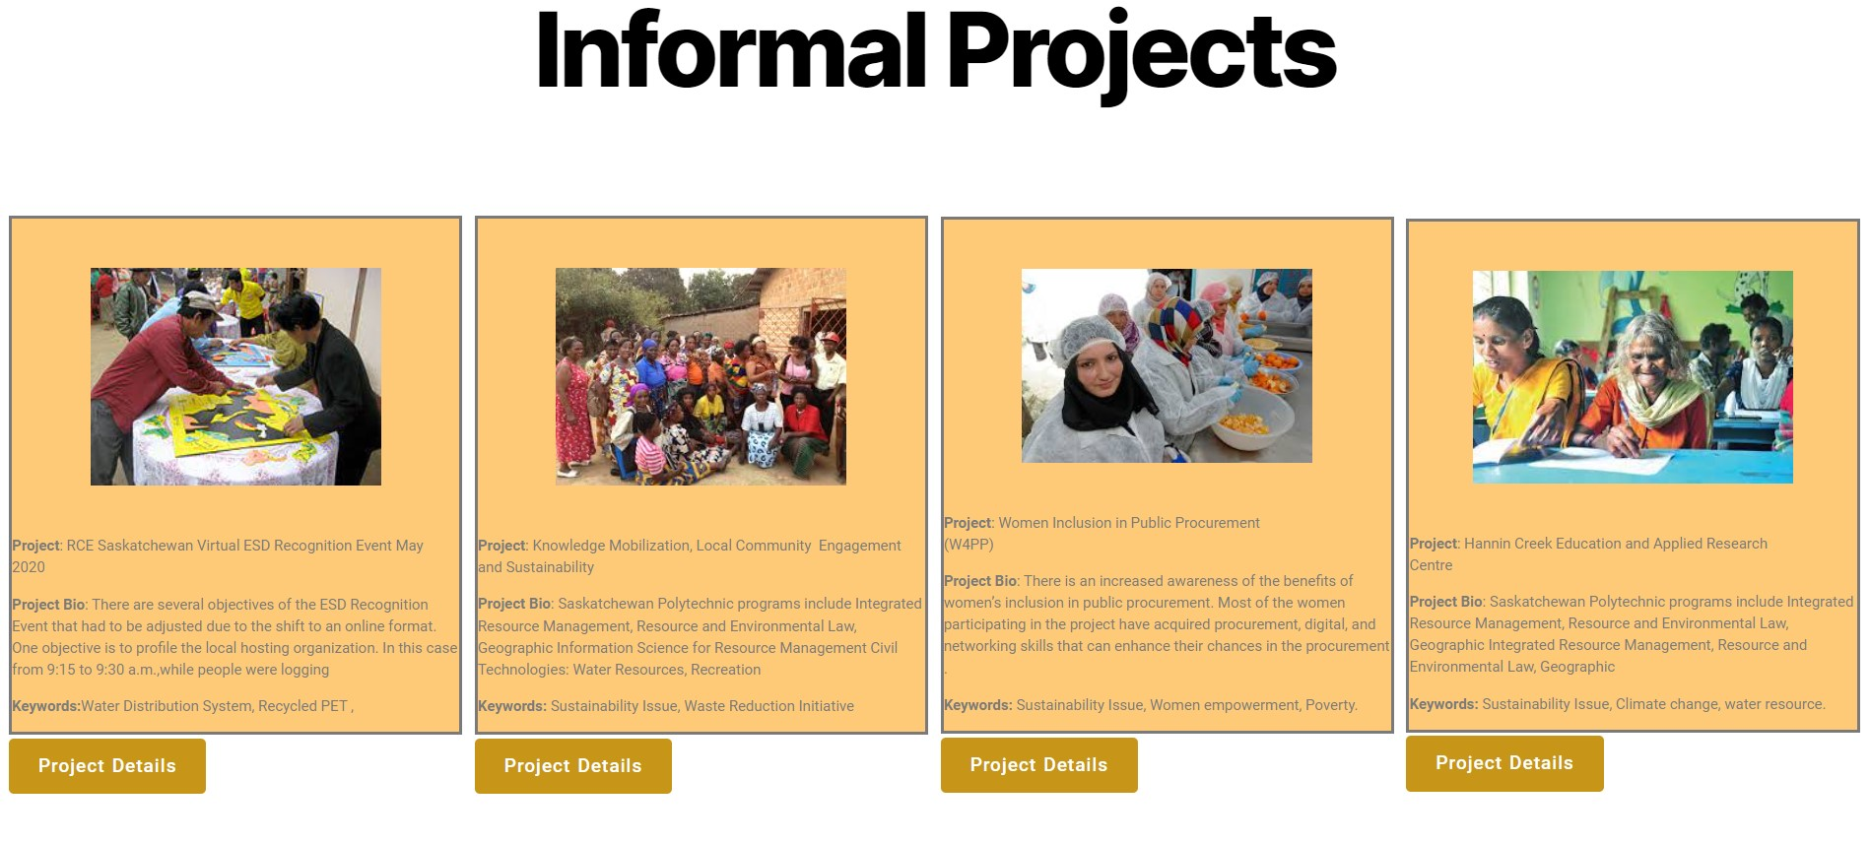
Demo( Screenshots)

Slide 8


Demo( Screenshots)

